Slide 1
Belgium
Di Lorenzo Scudieri e Luca Pinardi

Slide 2
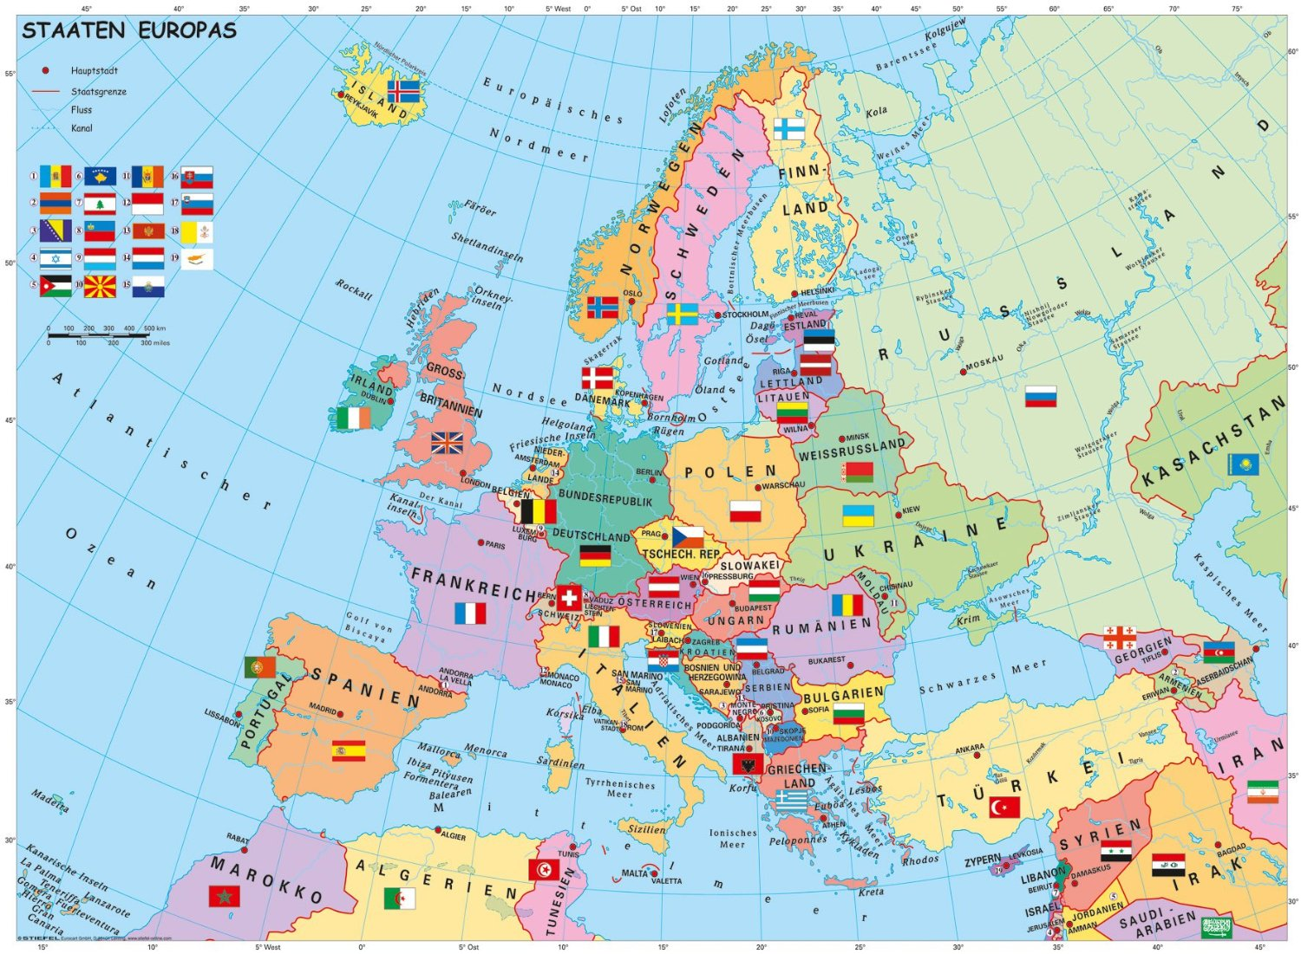
Map of Europe

Slide 3
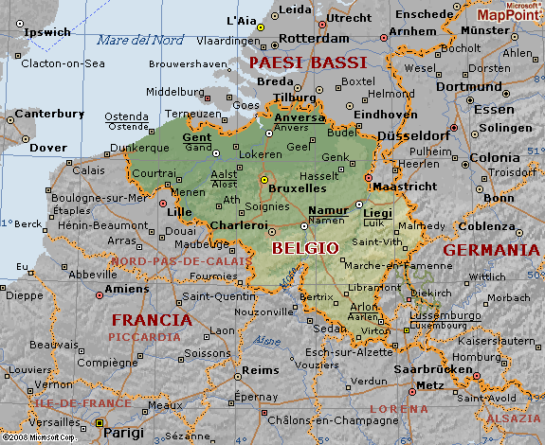
Physical map of Belgium

Slide 4
Territory and climate
Territory: Belgium is consists of three areas: the coastal plain, situated in the North- West, the central plain and the mountainous region of Ardenne, situated in the South- East. The three most importants rivers are Schelda (Scheldt), Oise and Mosa (Meuse).
Climate: The climate is Atlantic, characterized by strong humidity and few variations of temperature. In winter, on the mountains, the climate is colde.

Slide 5
Population, languages and religion
Population: Belgium has a population of about 11 million people. The population density is in general very high but there are some areas that aren’t very densely populated.
Languages Spoken: People in the North speak Dutch and in the South they speak French.
Ethnic Groups: There a three ethnic groups: The Flemish group, the Walloons and the Germans.
Religion: The majority part of people is Catholic. The rest of the people is Protestant. There are also some religious minorities.

Slide 6
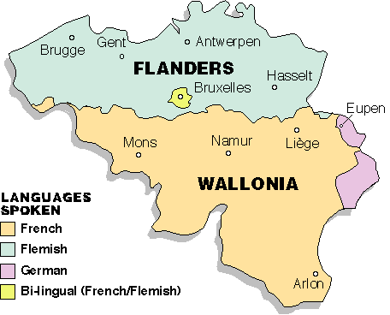
Politics
Belgium is a constitutional monarchy. There are three Regions: the Flemish Region (Flanders), the Brussels-Capital Region and the Walloon Region (Wallonia).
It is a founding member of the European Union.

Slide 7
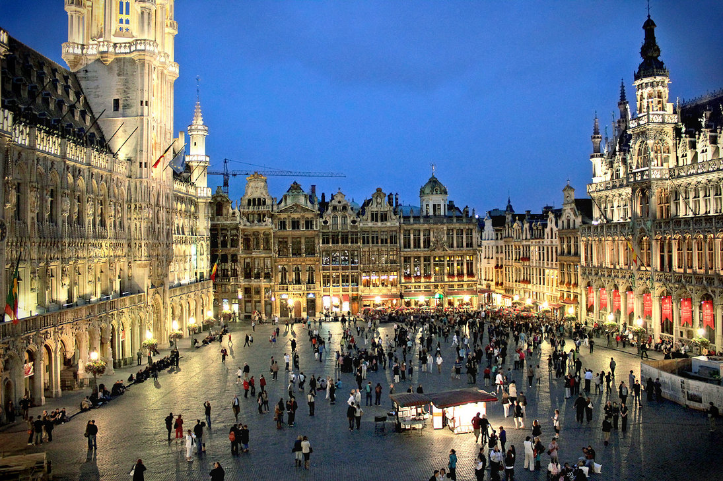
Major cities
Major cities: The capital city is Bruxelles. Other important cities are: Antwerp, Ghent and Charleroi.
Bruxelles

Slide 8
History
Belgium was populated by Celtic tribe called the Belgae. The Belgae lived in the area of Belgium until they were conquered by the Roman Empire in 100 BC.
North people learned the language and culture of the Germans and in the south people continued to be Romanized and spoke Latin. Over the next several hundred years Belgium came under the rule of many different dynasties and empires.
In 1795 Belgium became part of France after being captured during the Napoleonic wars. After the war it became part of the Netherlands. In 1830, they gained their independence.

Slide 9
Economy
Primary sector: There is cattle and swine breeding. The main crops are sugar beets, of tomatoes and potatoes. The most important mineral resource is coal.
Secondary sector: The major industries are: engineering and metal products, scientific instruments, chemicals, textiles, glass, oil .
Tertiary sector: The most developed sector is trade.

Slide 10
Cultural aspects
Cookery: The most important foods are chocolate, beer, French potatoes and mostly the Brussels sprout
Sport: The national sport is cycling.

